Slide 1
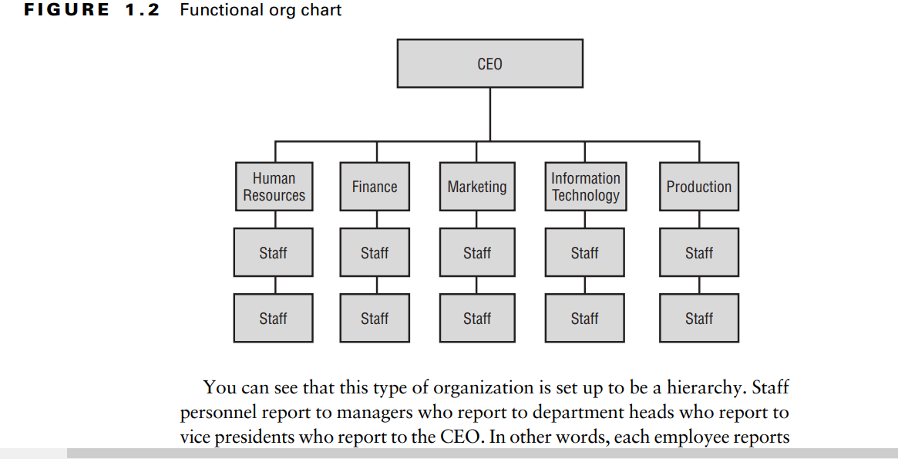

Slide 2
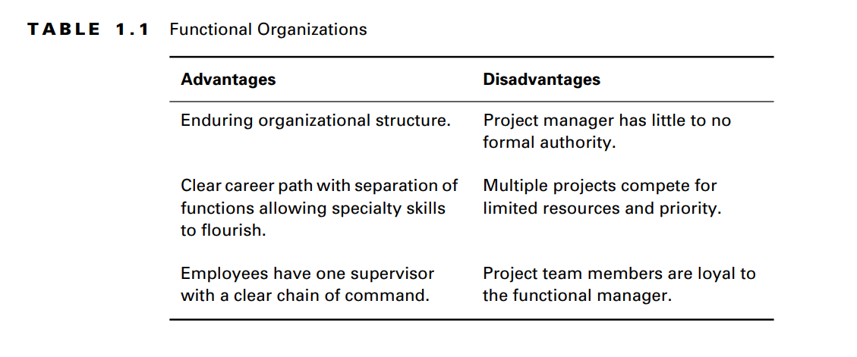

Slide 3
Projectized Organizations
Projectized organizations are nearly the opposite of functional organizations. The focus of this type of organization is the project itself.
The idea behind a projectized organization is to develop loyalty to the project, not to a functional manager.

Slide 4
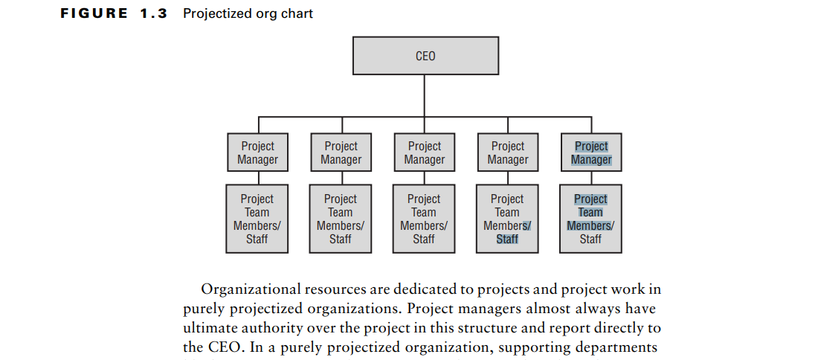

Slide 5
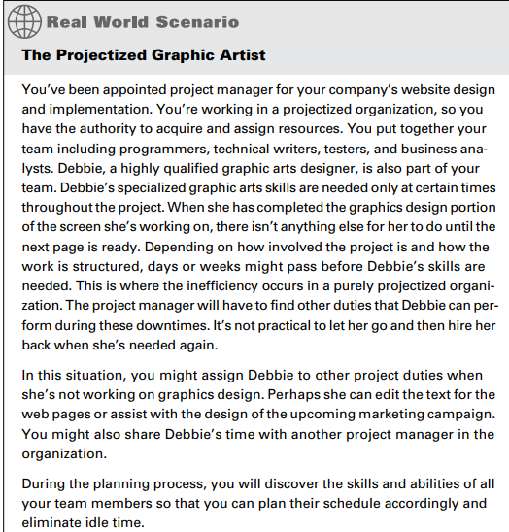

Slide 6
In summary, projectized organizations are identified several ways:
Project managers have ultimate authority over the project.
The focus of the organization is the project.
The organization’s resources are focused on projects and
project work.
Team members are collocated.
Loyalties are formed to the project, not to a functional manager.

Slide 7
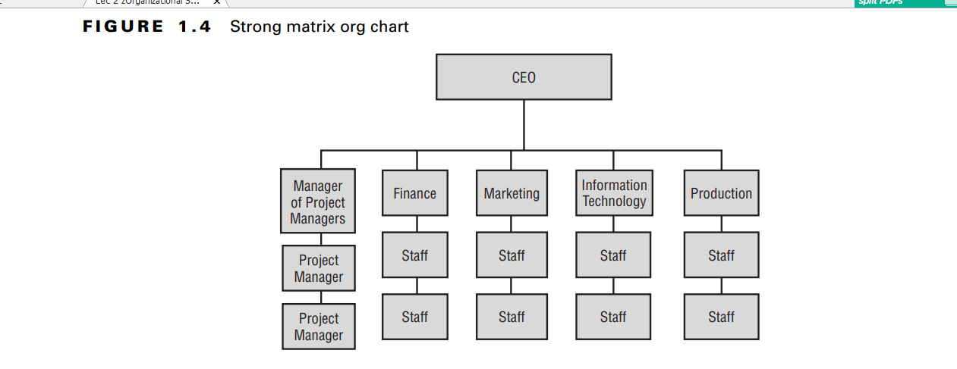

Slide 8
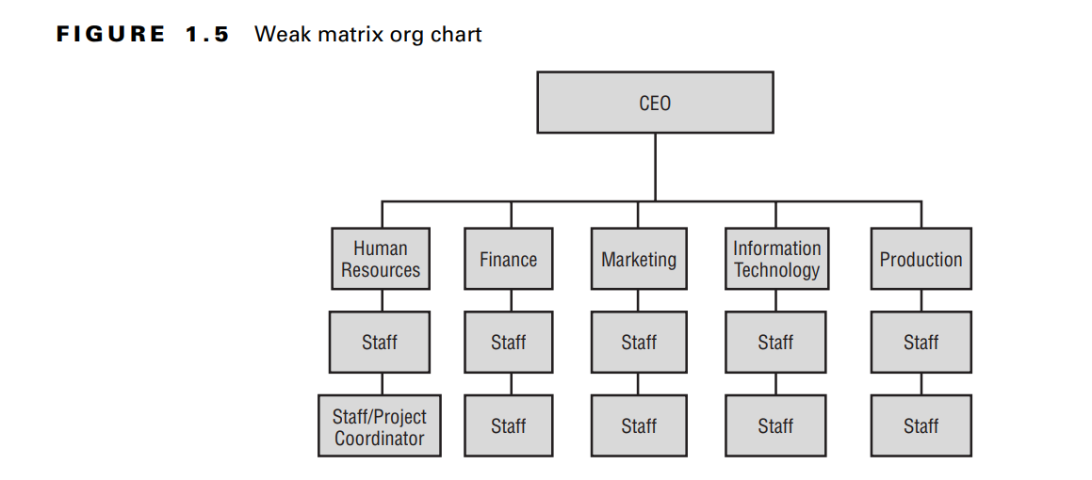

Slide 9
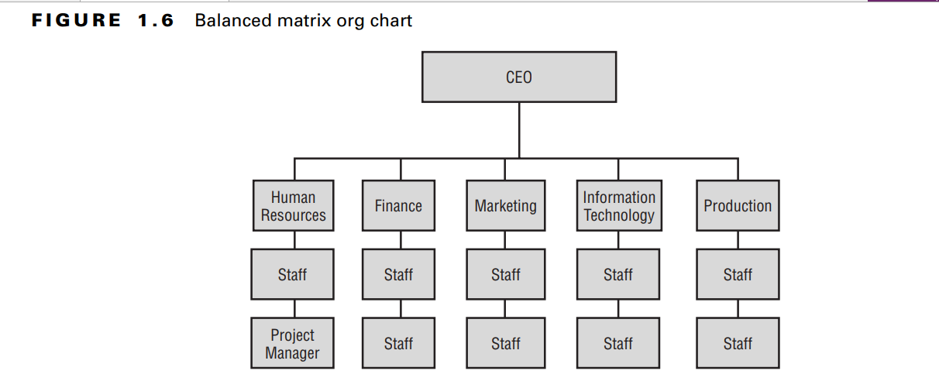

Slide 10
